Slide 1
Tensorflow
Introduction
Nikolaos Vasiloglou
Alex Dimakis

Slide 2
A little bit about MLTrain
Why do I need to know the details of tensorFlow
Learning from mistakes, we don’t give you working code
Day 1, more TF less deep learning, some applications towards the end
Emphasis on debugging and theory
If keras is the best then why TensorFlow
Why do I need to know some theory behind TF and ML?
Do I need to know how to code papers
Day 2, more emphasis on applications (and keras)
We will provide more material than we are going to cover

Slide 3
What is this training about?
Programming and a bit of Datascience
Architecture of TF
Translating Linear Algebra to TF
Doing optimization in TF
Coding of ML in TF
Things to worry about
Making mistakes while running simple code

Slide 4
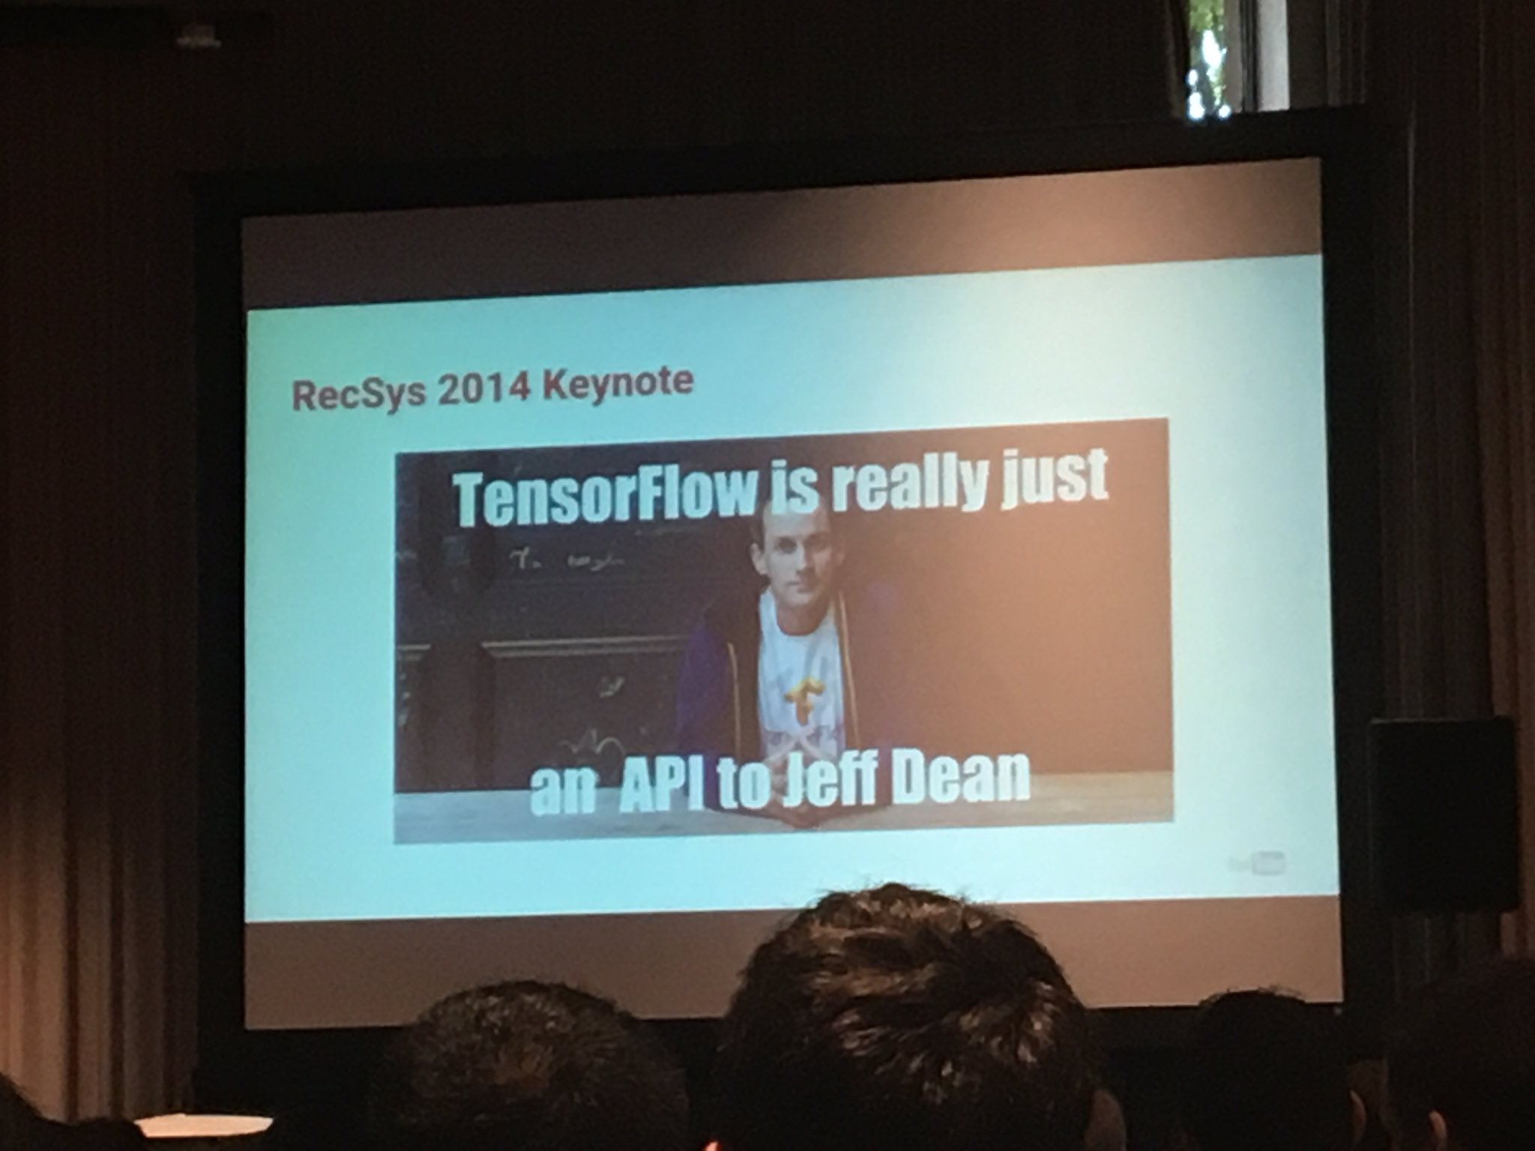
What is tensorflow?

Slide 5
Why Tensorflow?
TF is a platform that works really well for computationally heavy problems that
Need to run in different platforms
Need to parallelize easily
Distribute easily
TF was mainly developed to solve deep learning problems
TF has problems with slow IO
TF is slower than scipy on computationally light problems
TF has not very good data management functionality
TF had to be developed quickly so there are some design flaws
TF follows the software life-cycle

Slide 6
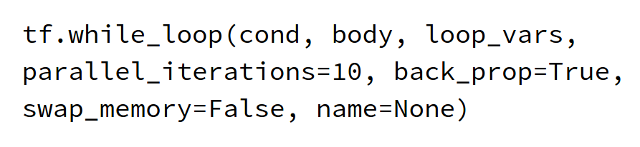
Evidence of design flaw

Slide 7
TF will Evolve like hadoop
It was designed to solve web indexing
It had to be done fast so that there were a lot of design holes
Excellent performance in one class of problems
People were optimistic about how far it could go
They tried to patch the holes
Eventually they had to re do it by fixing some of the holes
Spark was born
A lot of holes still exist

Slide 8
Tensorflow’s Evolution is Keras
It is a higher level framework
It has better abstractions
It can compile to frameworks other than TF
It does not expose a lot of low level details

Slide 9
Despite some complaints...
TF is still the best framework to program ML
Has great support and fast development
Performance is improved
Holes are patched
It is much easier than scikit and other frameworks than other large scale problems
A lot of cool deep learning papers are available there!!

Slide 10
Life beyond TF
API’s will eventually be replaced by compiler optimizations
Parallelization will become less explicit
Mxnet is a serious competitor and worth looking at. Still behind though.

Slide 11
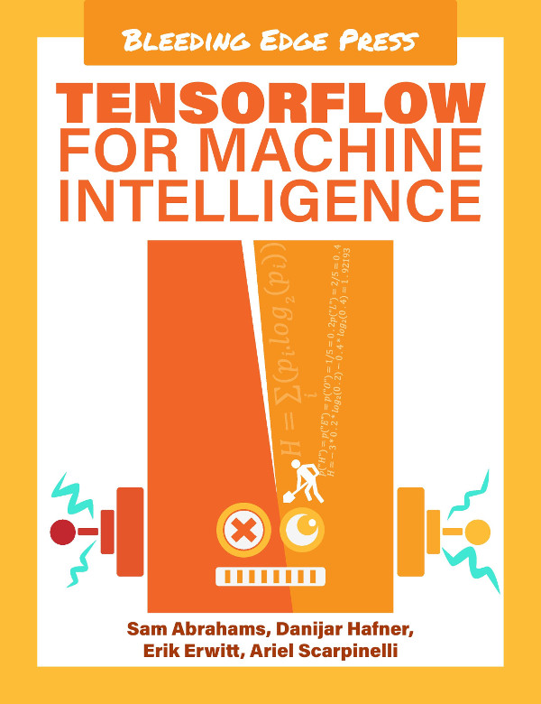
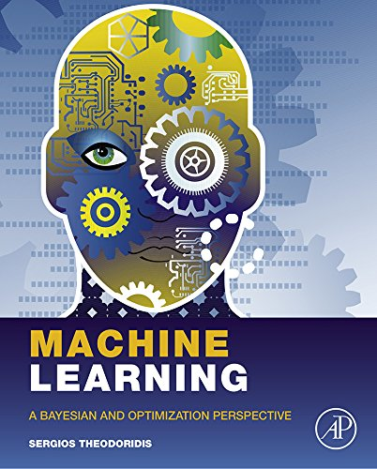
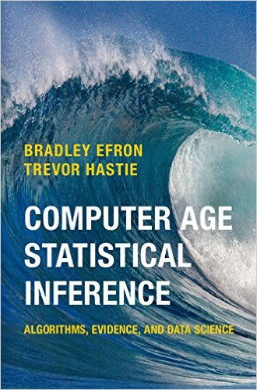
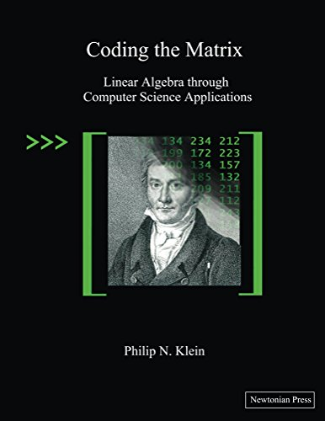
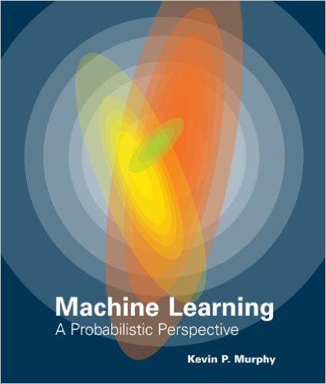
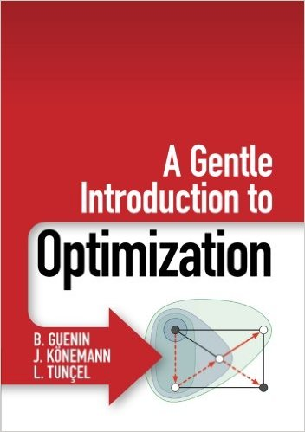
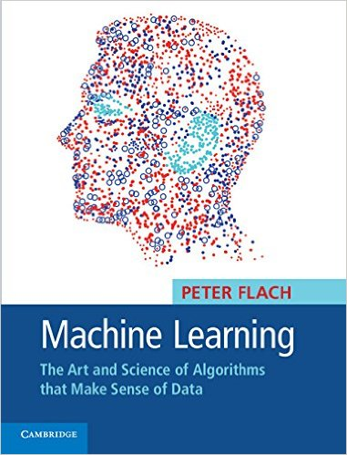
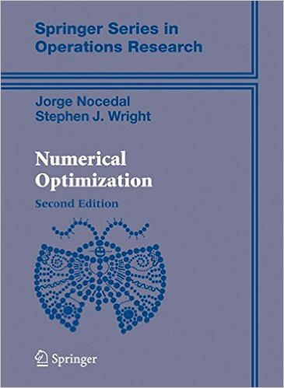
References

Slide 12
What have you LearnT So FAR
Tensorflow is
getting closer to become the standard for deep learning
is not a black box, you can develop your own algorithms
not perfect and many things have to be fixed
very popular

Slide 13
A little bit of history

Slide 14
Before TensorFlow
Linear Algebra packages
Matlab
Scipy
Octave
Express algorithms as vectorized operations
GPU efficient
MMX efficient

Slide 15
Basic drawbacks
Parallelization has to be explicit
Parallelization could only be bulk synchronous
No support for asynchronous parallelization
Designed for high precision-- more data, more time

Slide 16
The birth of tensorflow
Theano
Torch
They all had auto-diff, computational graphs, etc
TF improved
support to multiple platforms (mobile, etc)
Distributed-ish, multi-gpu
Lossy compression of Floats, low precision inexact computations
Mindshshare: TF has more community adoption

Slide 17
Tensorflow Architecture

Slide 18
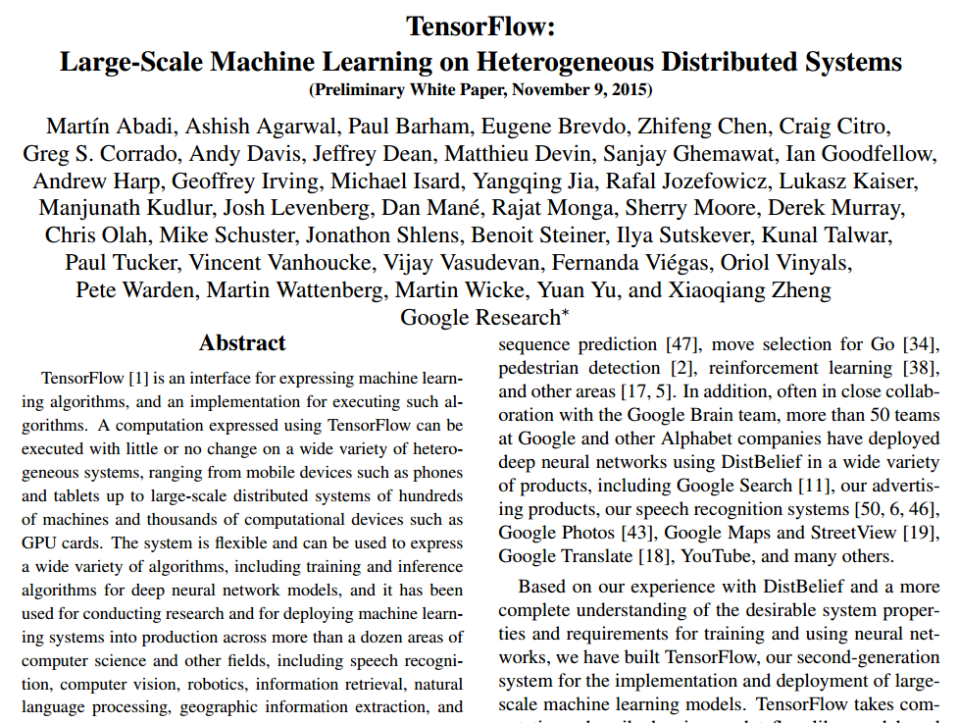
November 9 2015

Slide 19
The Execution Graph Approach
In C++/python you focus on the sequence of computations
In TF you declare the computations you want to do
The compiler
identifies the dependencies
schedules the computations
does the distribution/gpu translation
More time left for dealing with the problem and not the implementation!!!!

Slide 20
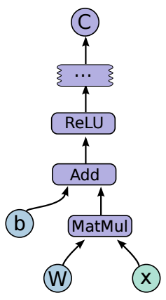
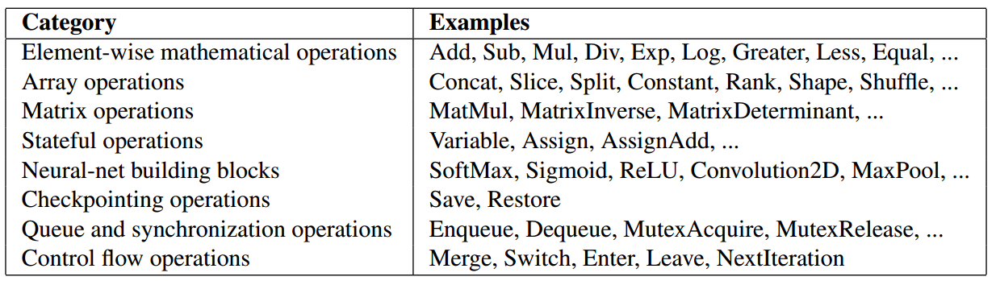
The computational graph A simple Example

Slide 21
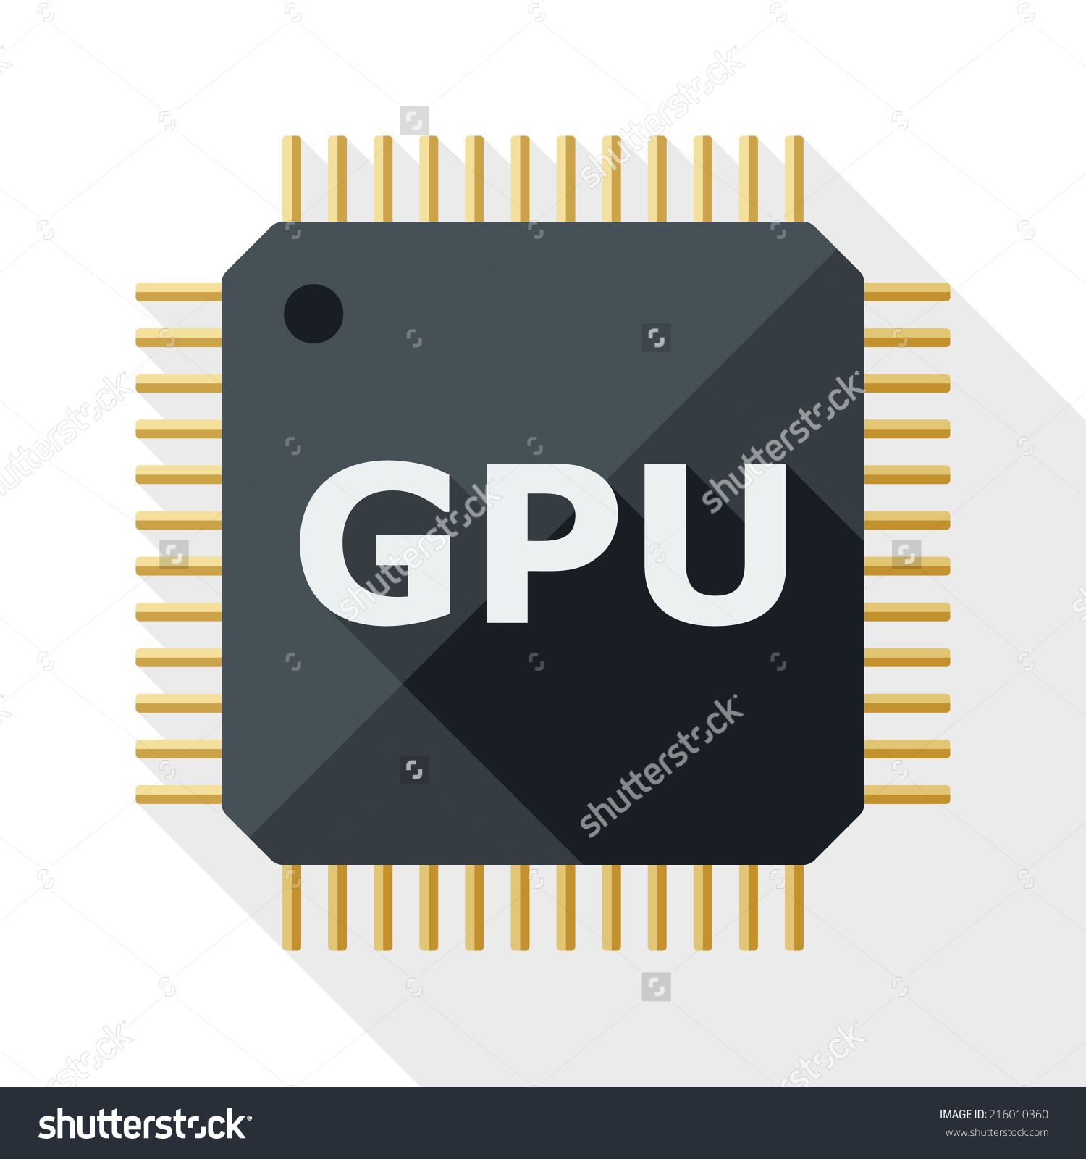

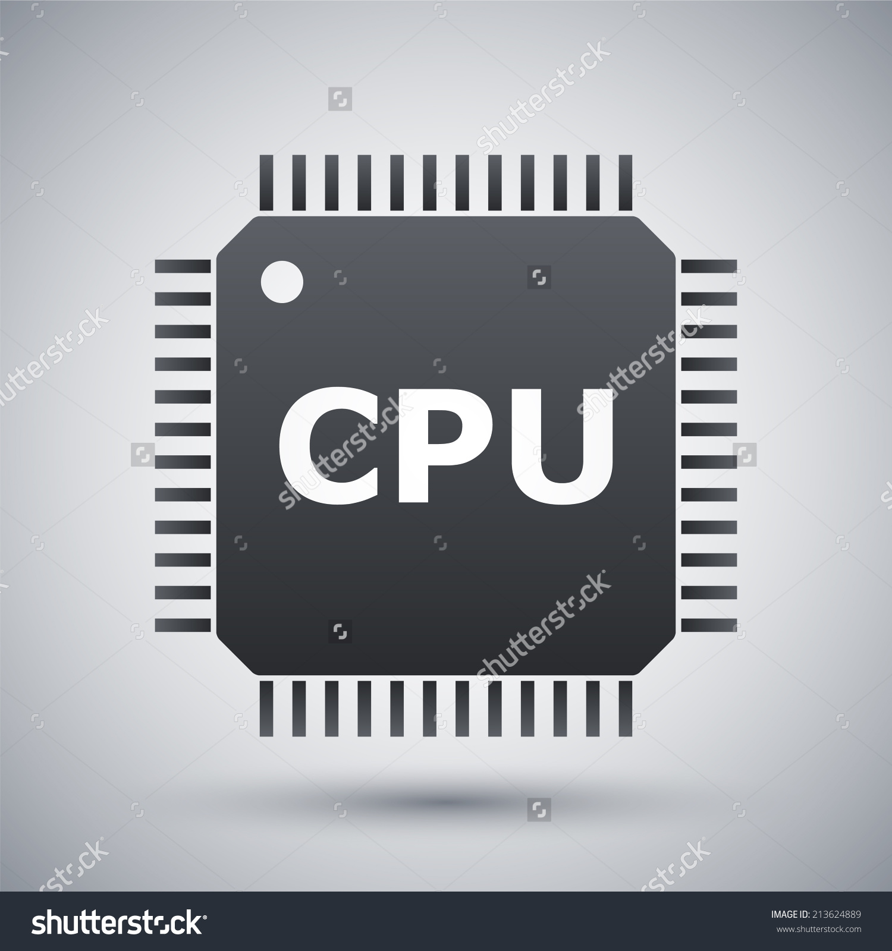


Now Run EveryWhere!!!
Multithreaded
Multi GPU
Distributed
Multi platform

Slide 22
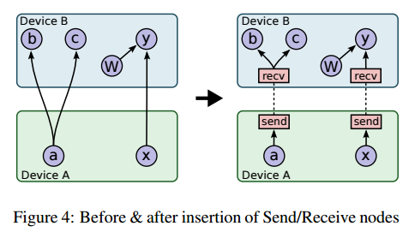
A Little Bit about the automatic Distribution
Distribution the CompGraph is as difficult as key ordering in joins
Simulates execution
Cost function over graph
Make sure resources are available on nodes

Slide 23
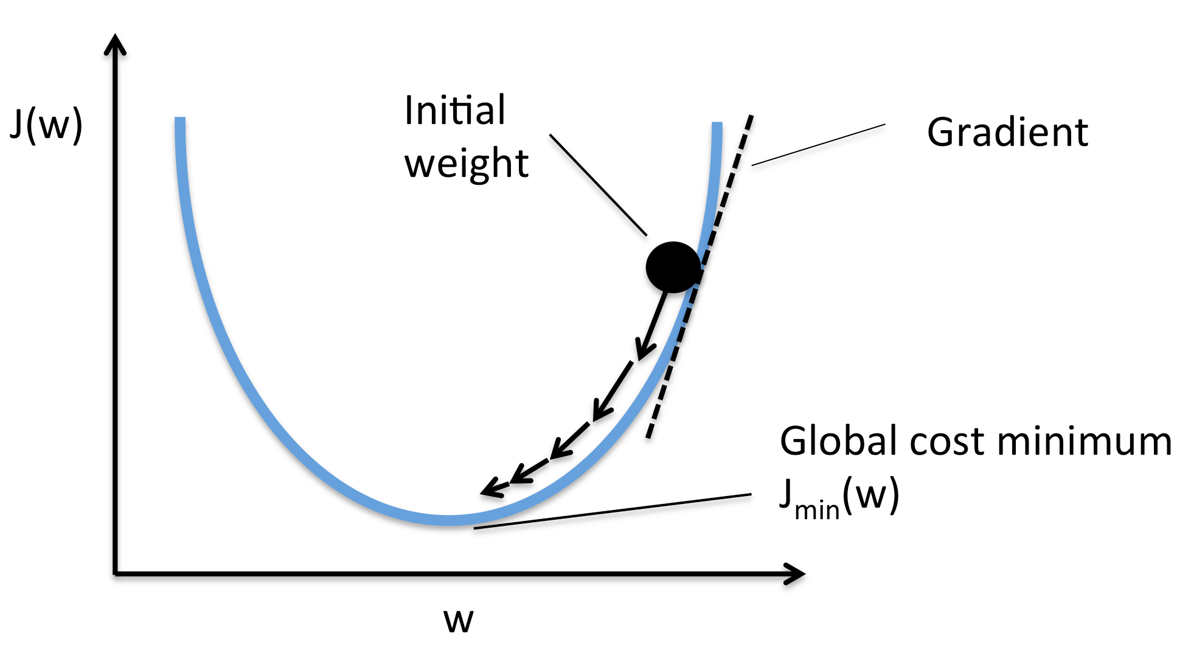
TF executes but also Learns
In order to learn you need to be able to differentiate!!!
Given any engineering system you need to know how to shake the parameters to improve performance
This direction is the GRADIENT!!!!

Slide 24
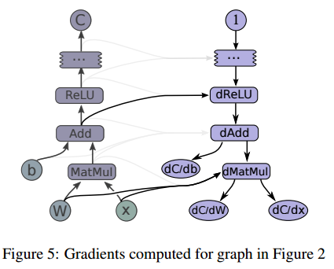
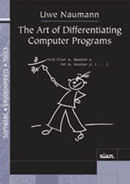
Automatic differentiation
[db,dW,dx] = tf.gradients(C, [b,W,x])

Slide 25
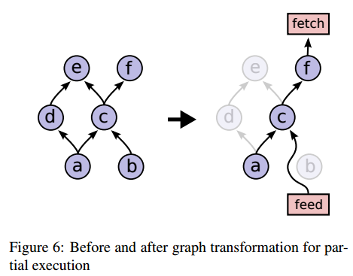
Partial Execution
After defining the computational graph we can turn evaluate some parts
Partial update is not necessarily incremental update
Incremental update is possible but hard to debug

Slide 26
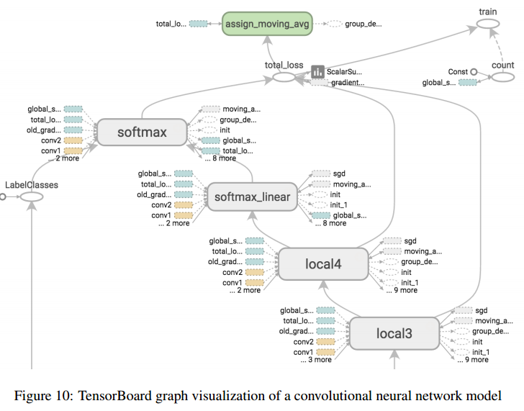
Debugging

Slide 27
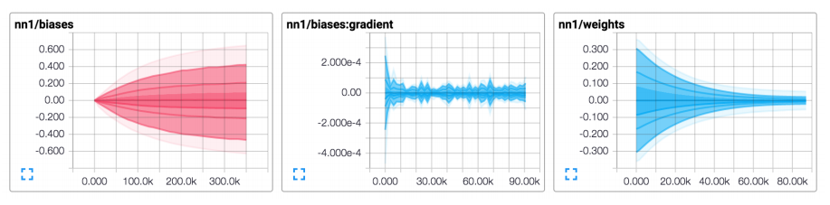
Visualization and monitoring

Slide 28
What have you Learnt so far?
Tensorflow Architecture offers several layers of automation
Computation scheduling/parallelization
Platform translation
Distribution
Differentiation
TF operations are all transparent to you through visualization

Slide 29
Discussion

